Slide 1
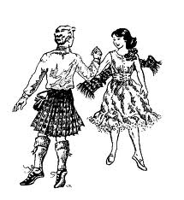
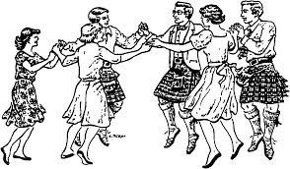
Memory for Scottish Dance
Now, how did that dance go?
Notes:
Was it the one that started with turn by the right? Did it end with a circle?

Slide 2
Think about what you did to prepare for this weekend
Did you study the dances for the ball tonight?
Did you go to a preparation class?
Will you go to a ball prep class next?
Did you read through the dances?
Did you walk things through in your living room?
Talk to a person next to you and tell them what you did.
Notes:
Here are a lot of questions about how you prepare for a dance. Read them through and then talk to the person next to you, threesomes are fine. One of the concepts that learning specialists talk about is METACOGNITION. Thinking about how you think is important in being able to do well at remembering.

Slide 3
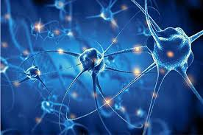
Crash course on your brain
Neurons and learning
https://www.youtube.com/watch?v=ucQQCa_kA0U
Making connections
Notes:
Learning happens when you make connections between neurons in your brain. When neurons fire at the same time they make stronger connections and learning happens.

Slide 4
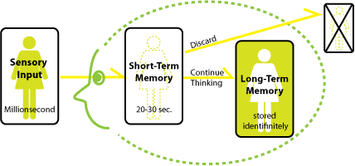

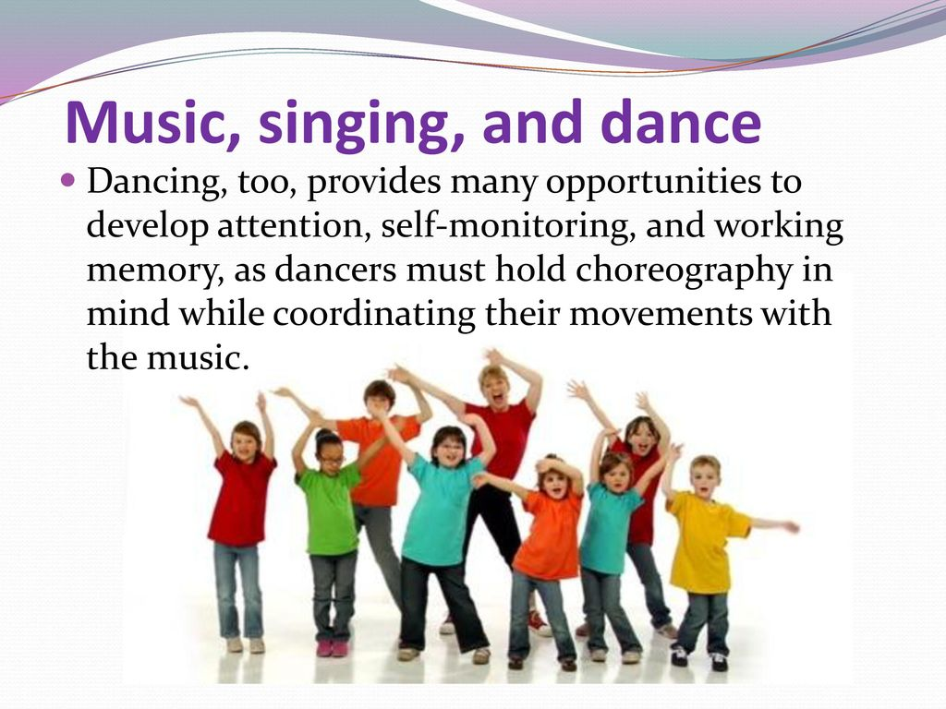
Types of Memory
Short term memory
Working memory
Long term memory
Notes:
Short term memory depends on what you pay attention to. Your brain can only deal with what you are actively thinking about. think of it as sorting messages into spam and things you want to deal with. When you are listening to a talk through, there may be other people talking, radiators clanging, a fire engine passing by, etc. You need to focus to let go of the spam.
Working memory is what you need to remember for the length of time of the task. You need to remember the formations while you are doing the steps and paying attention to your partner. Working memory can get overloaded pretty easily. It can hold 7 items +/- 2.
Long term memory: this is permanent memory. It can be procedural or declarative; how to do the skip change or how Maxwell’s Rant begins. The way to put something into long term memory is to work with it in working memory. This is where classes and step practice can help to make steps automatic so you have some brain power left for the formations.
Here is a diagram that might help you see how memory works. The rest of this presentation is about how to do the “continue thinking” part effectively.

Slide 5
Mirror Neurons
ATTENTION
When someone else is dancing or demonstrating, the neurons in your brain are also firing, but only if you are paying attention.
A
T
T
E
N
T
I
O
N
Notes:
One thing that is very important in remembering is paying attention to the right inputs.

Slide 6
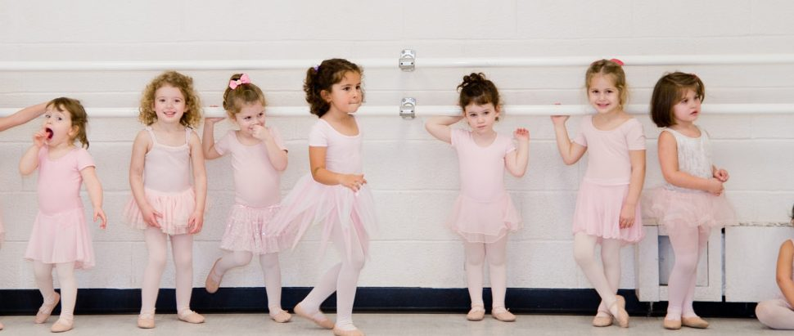
Interference with memory
Distractions from within also interfere with memory
Notes:
It is not only external stimuli that can interfere with memory.
Your brain can distract itself from inside
Emotions are particularly distracting
My favorite saying is that children are very different from adults, but adults are just like children. You might be like the first little girl whose tooth is loose, but your distraction is pain. You might have had a bad day at work and that is causing you to be distracted. All of this distraction interferes with attention, which is essential to memory.

Slide 7
Memory relies on meaning
      I B M L O L U S A C D
Notes:
See how many of the letters I flash on the board you can remember. Tell the person next to you the letters that you remember. How many did you remember?

Slide 8
With Meaning: Easier to Remember
IBM LOL USA CD
Notes:
Meaning makes it easier to remember because it you have fewer items to remember. Working memory can only hold 7 (+-2) items. That is why phone numbers were seven digits.

Slide 9
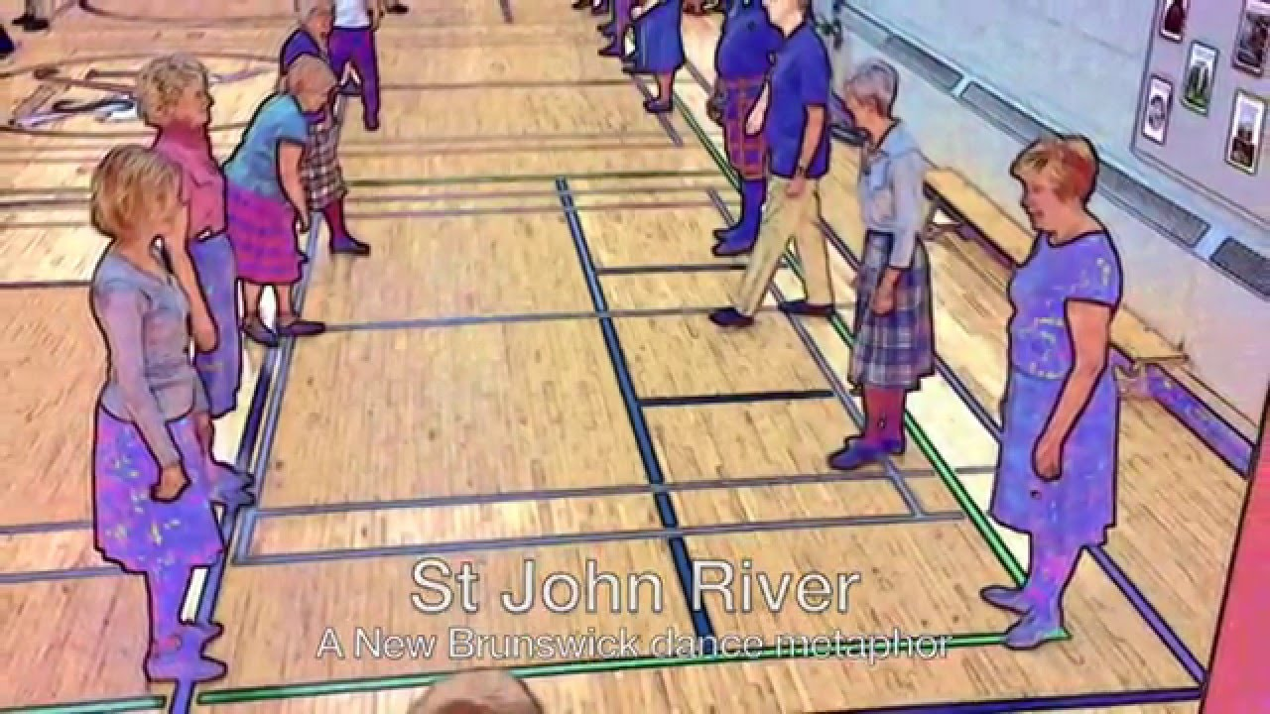
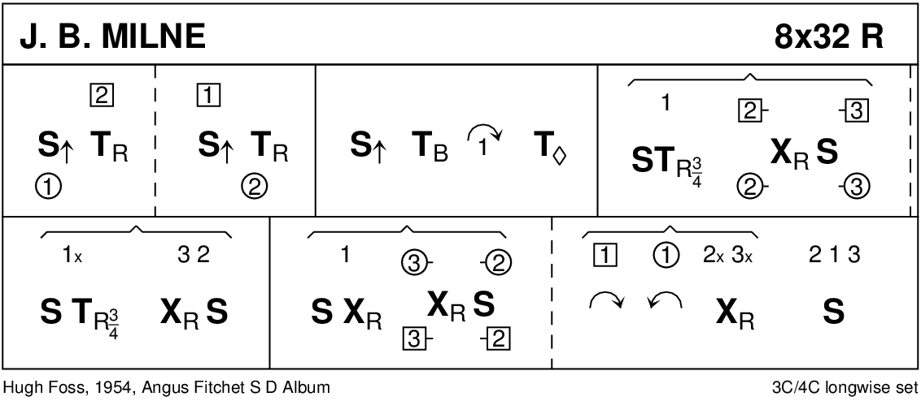
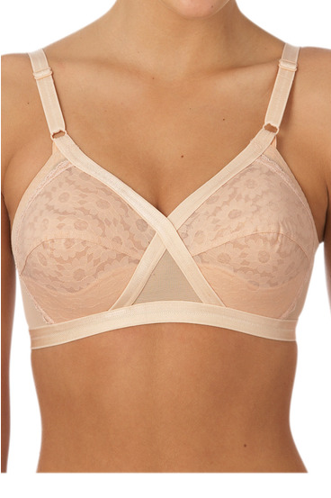
MEANING
Our minds do not remember meaningless info well.
Stories can help
Shapes can help
Humor really helps.
Notes:
How can you get meaning into dances? Some dances have stories like St. John River, or Kinmont Willie. Or Get Your Shoes on Faster. Sometimes you can remember the formations as shapes. OX can be circle four hands round and back followed by hands across and back. Have you ever done the brassiere dance? Fair Donald? B cup, C cup, Cross your heart.

Slide 10
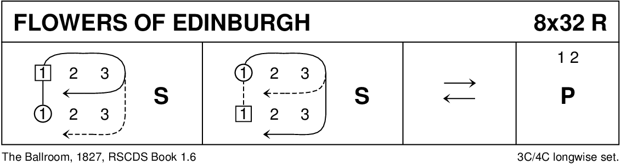
ENCODE in chunks
Condense the information in order to remember it
Choice one
Choice two
First woman casts off, followed by her partner, dances two places down the dance, crosses below third couple, dances up to her partner’s place and sets. First man follows his partner and dances up the center of the dance to her place and sets. First man then casts off, followed by his partner, dances two places down the dance, crosses below third couple, dances up to his original place and sets. First woman follows her partner and dances up the center of the dance to her original place and sets. The first couple then takes right hand in right, dances four skip change of step down the center of the dance, turns while retaining right hands and leads up the center of the dance to finish in first place with both hands joined. Second couple steps in on bar 24 to join both hands. They dance eight bars of pas de basque, on the first bar they dance away from the center, first couple towards the men’s side and second couple towards the women’s side. On the second step, each person pulls back on right hand to do a quarter turn so the couples are facing up or down. On the third step, the couples progress up or down the set with pas de basque. On the fourth step, both couples pull right shoulders back to do one quarter turn. On the fifth step, both couples take one pas de basque step toward the center of the dance. On the sixth step, both couples pull right shoulders back and turn one half way to own sides of the dance. On the seventh and eighth steps, all dancers retire with pas de basque steps to own sides in progressed places.
Chase and set, chase and set, down the middle and up poussette.
Notes:
First woman casts off, followed by her partner, dances two places down the dance, crosses below third couple, dances up to her partner’s place and sets. First man follows his partner and dances up the center of the dance to her place and sets. First man then casts off, followed by his partner, dances two places down the dance, crosses below third couple, dances up to his original place and sets. First woman follows her partner and dances up the center of the dance to her original place and sets. The first couple then takes right hand in right, dances four skip change of step down the center of the dance, turns while retaining right hands and leads up the center of the dance to finish in first place with both hands joined. Second couple steps in on bar 24 to join both hands. They dance eight bars of pas de basque, on the first bar they dance away from the center, first couple towards the men’s side and second couple towards the women’s side. On the second step, each person pulls back on right hand to do a quarter turn so the couples are facing up or down. On the third step, the couples progress up or down the set with pas de basque. On the fourth step, both couples pull right shoulders back to do one quarter turn. On the fifth step, both couples take one pas de basque step toward the center of the dance. On the sixth step, both couples pull right shoulders back and turn one half way to own sides of the dance. On the seventh and eighth steps, all dancers retire with pas de basque steps to own sides in progressed places.
Chase and set, chase and set, down the middle and up Poussette.

Slide 11
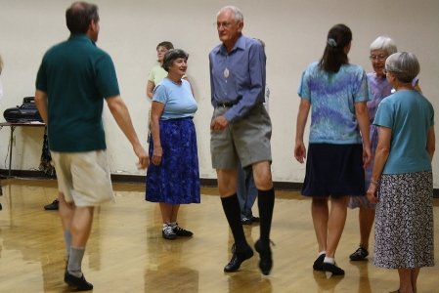
MULTISENSORY
Listen, look, move all at the same time.
Notes:
The more senses you use when learning something, the better you will remember it. If someone else is doing a walk through, or dancing, picture yourself in their places.

Slide 12
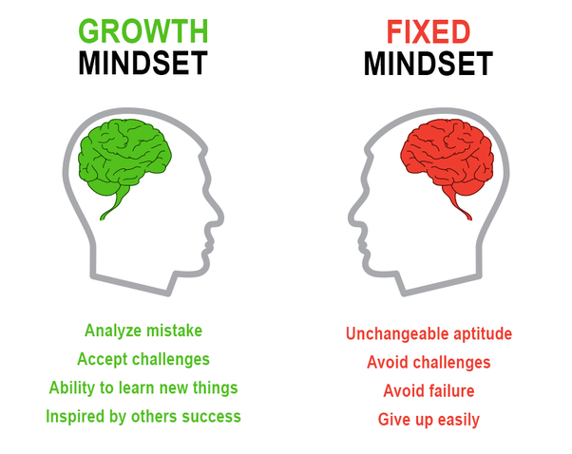
OPTIMISM
If you tell yourself you will not remember, you probably won't.
Growth Mindset – I can get better at this.
Fixed Mindset – I am as good a dancer as I will ever be.
Notes:
This one is sort of hard to describe, but it is definitely true. If you tell yourself something enough you may begin to believe it.

Slide 13
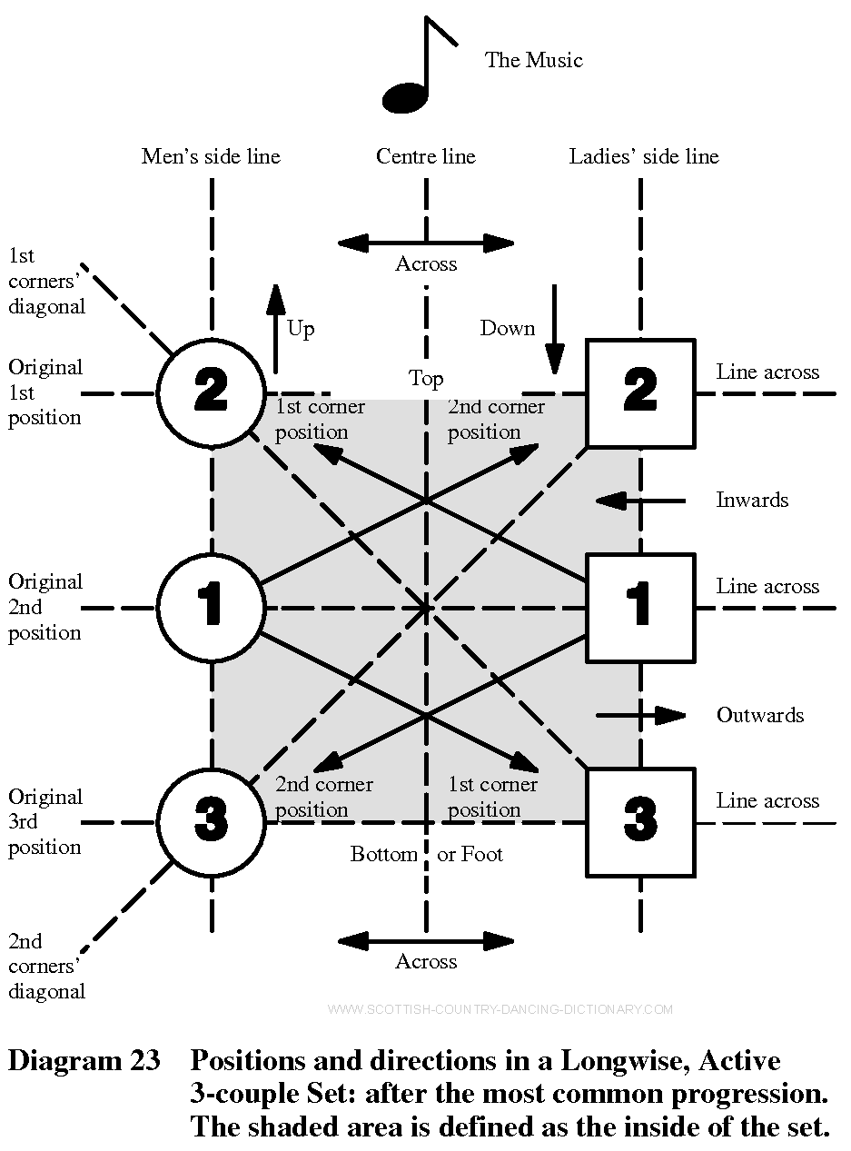

RELATIONSHIP
Connections are essential in remembering
Notes:
Connections and relationships are really important in remembering. For example, there are many dances where the corners get moved around in some way and then two half reels of four get them back to places. If you have a sense of the relationships of the corner formations, it can help you remember to do them.
Spatial relationships are helpful too. If you can picture the set as seen from above, like a Pilling diagram, it can be a helpful way to connect the words to the movements

Slide 14
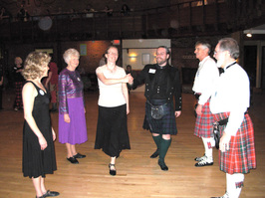
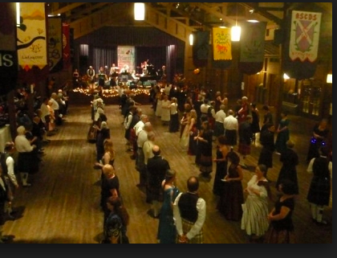
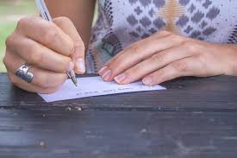
YOU NEED TO DO IT
Active learning is the key
Volunteer to be the couple to walk through a dance
Make sure you are doing something to process the information as a teacher is teaching, or as the MC is briefing the dance.
If you are preparing for a ball or other dance where you want to remember the dances, write them down. Research shows that we remember things better when we write them down.
Notes:
Here is the bad news: this is not easy. You do have to work at it. In order to chunk information into manageable units, you need to make some of it automatic and you can only do that with practice. . Some people use their hands to make the motions of the dance. Research shows that we remember things better when we write them down.

Slide 15
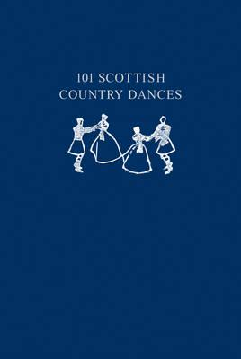
Time to try
I am going to brief a dance you have never seen. Then I would like you to try to dance it from the talk through. See if you can use any of these techniques to help you.
We will use some more of the techniques and see if you can remember it better.

Slide 16
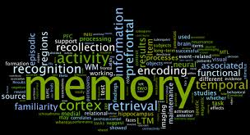
MEMORY
M eaning
E ncode in chunks
M ultisensory
O ptimism
R elationship
Y ou need to do it

Slide 17
If you would like a copy
I would be happy to share a copy of this presentation and/or a copy of the MEMORY sheet.
Just send me an email requesting it/them and I will send what you request back to you.
cecily.selling@gmail.com

